Slide 1

United State Census Bureau’s Analysis
Current Population Survery (CPS) - 2017
February, 2024

Slide 2

Summary
The Current Population Survey (CPS) is a monthly survey of households conducted by the United States Bureau of Census for the Bureau of Labour and Statistics. It provides comprehensive body of data on the labour force, employment, unemployment, persons not in the labour force, hours of work, earnings, other demographic and labour force characteristics.
This project Analyses the Basic CPS data for December 2017 to generate insights on selected metrics.
This project includes an end-to-end data engineering pipeline from extraction of data – pre-processing – data warehousing – analysis using Pyspark and python as well as visualisation using Apache Superset
Link to the Code base - GitHub

Slide 3
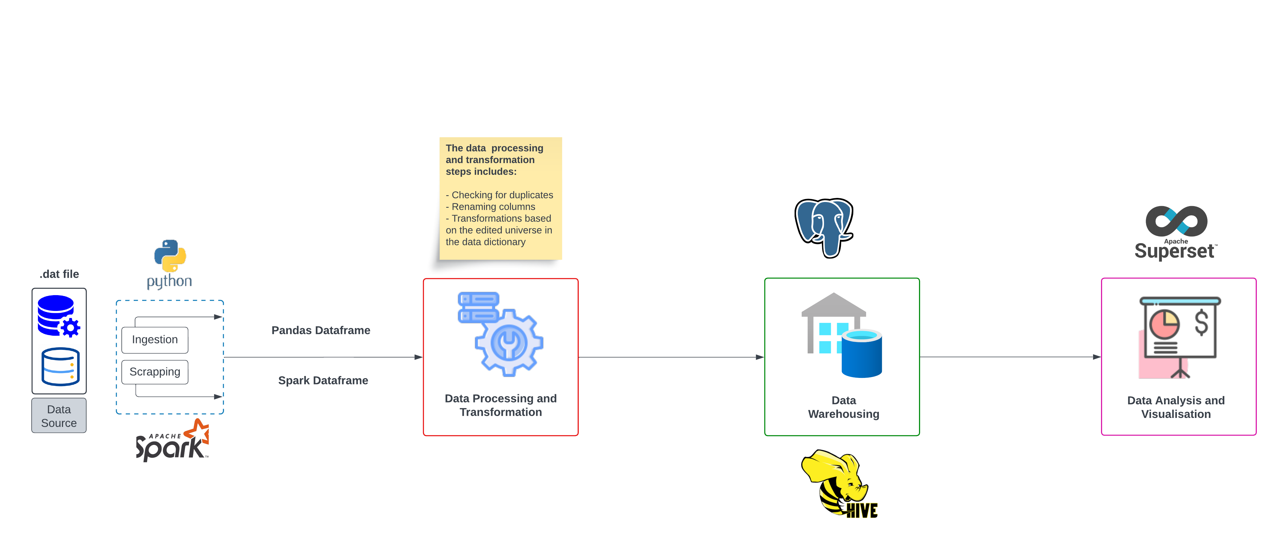
Architecture Diagram

Slide 4
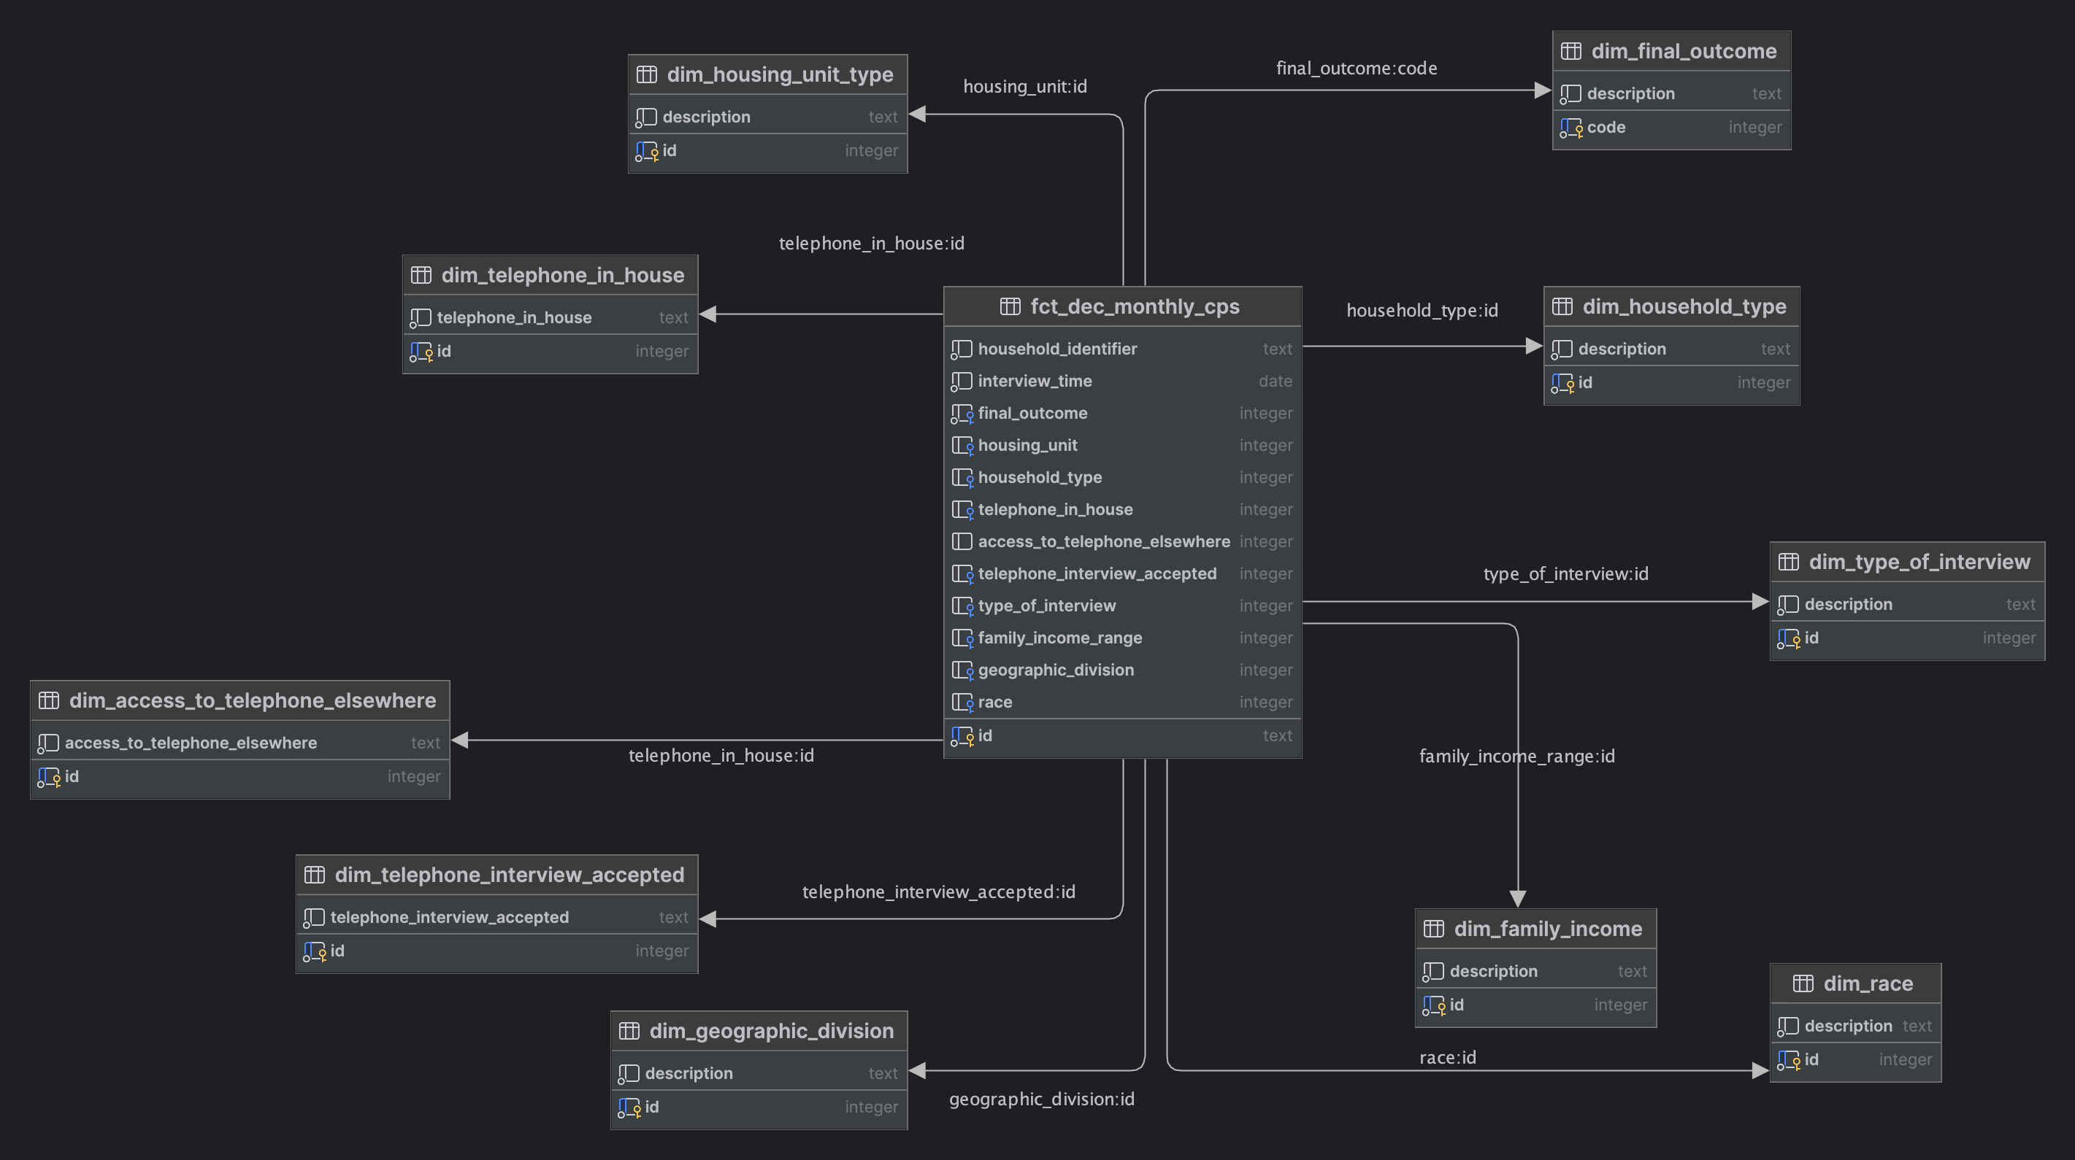
Data Model

Slide 5
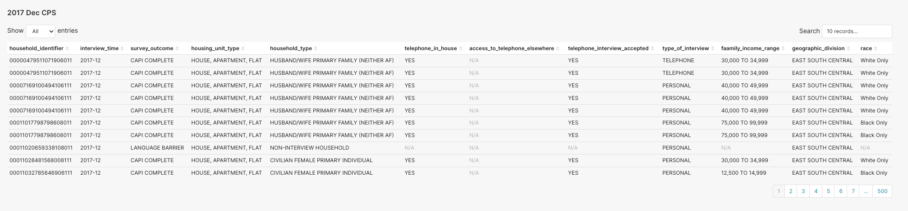
Data Visualization and Analysis Results
The are a total of 146,456 responders for the December 2017 CPS having responded to more than 200 questions.
The table above highlights a subset of the data (10 records) across twelve (12) selected variables of interest

Slide 6
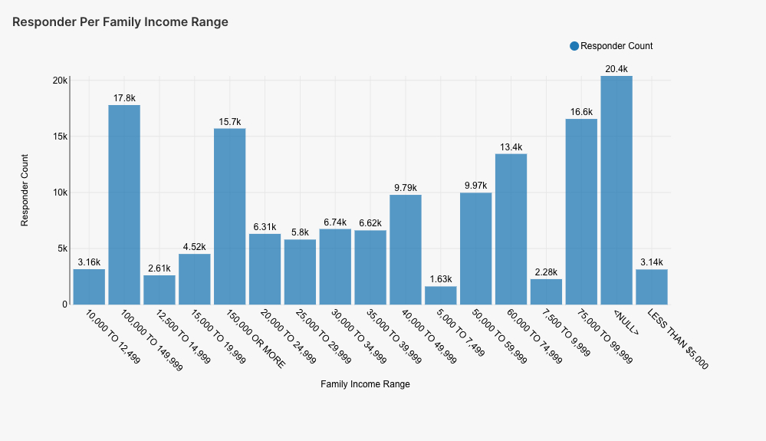
Data Visualization and Analysis Results Contd.
From the analysis, a higher number of responders did not indicate their family income range – more than 20.4k
Following that is the income range between 100,000 to $149,999 with more than 17.8k responders

Slide 7
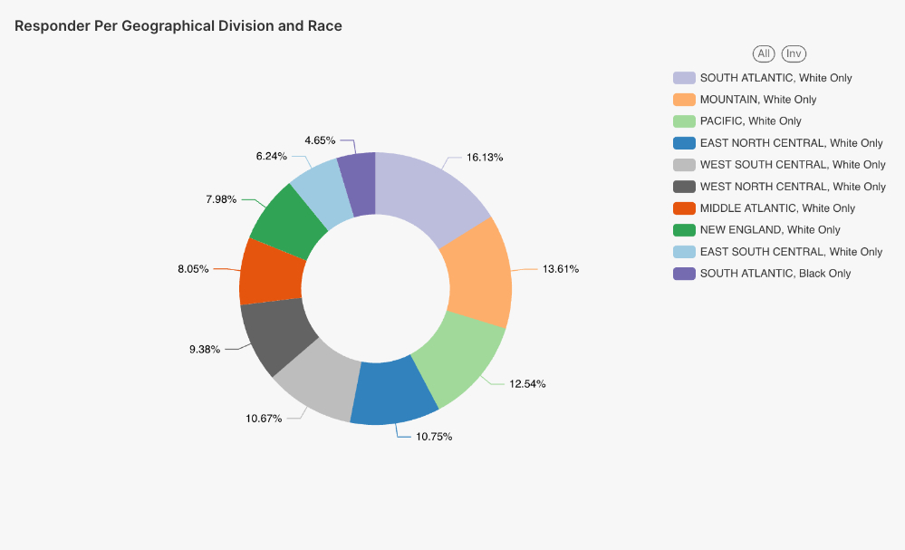
Data Visualization and Analysis Results Contd.
This shows the top ten responder per geographical division and race.
The sum make up for more 72% of the total responder for 2017 December CPS
The majority of responder (16.13%) are from SOUTH ATLANTIC division and of the White Only race.

Slide 8
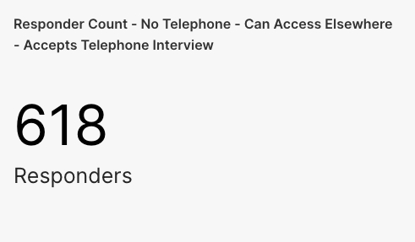
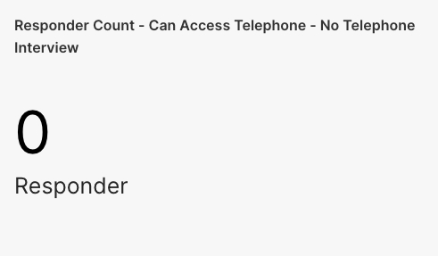
Data Visualization and Analysis Results Contd.
The count of responder with no telephone in the household and can access telephone elsewhere is 618. This directly means that 618 responders can have a phone interview by utilising a third-party phone.
Similarly, a responder who can access a phone ( those who have a phone or can access it elsewhere) might find it comfortable to have a phone interview

Slide 9
THANK YOU!

